Slide 1
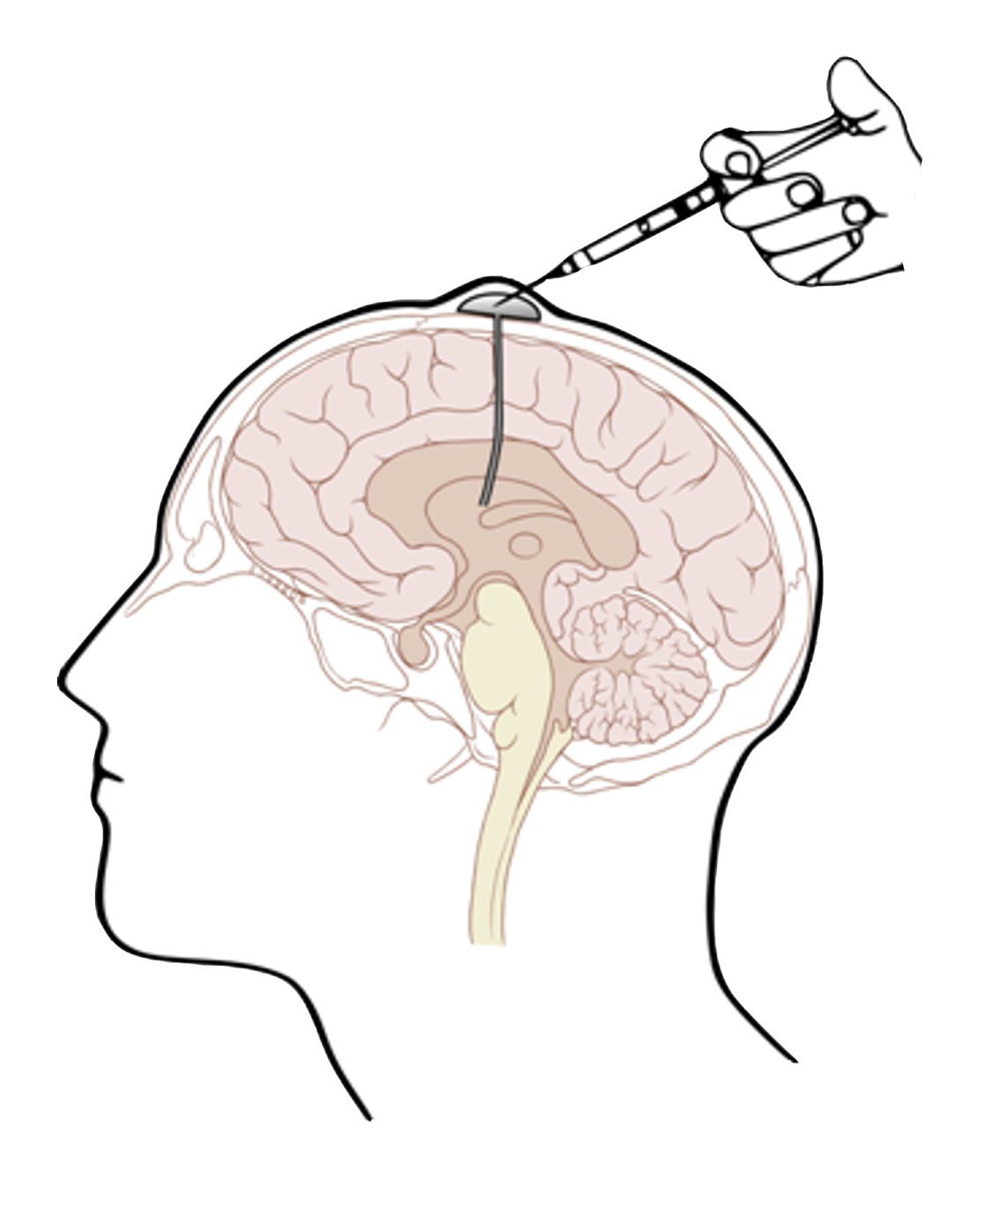
A Phase 1 Study to Evaluate Chimeric Antigen Receptor (CAR) T Cells Incorporating a Chlorotoxin Tumor-targeting Domain for Patients with MMP2+ Recurrent or Progressive Glioblastoma (NCT04214392)
Christine Brown, PhD
Professor in Hem/HCT and Immuno-Oncology
Deputy Director, T Cell Therapeutics Research Laboratories
City of Hope, Duarte, CA
June 4-8, 2021; online

Slide 2
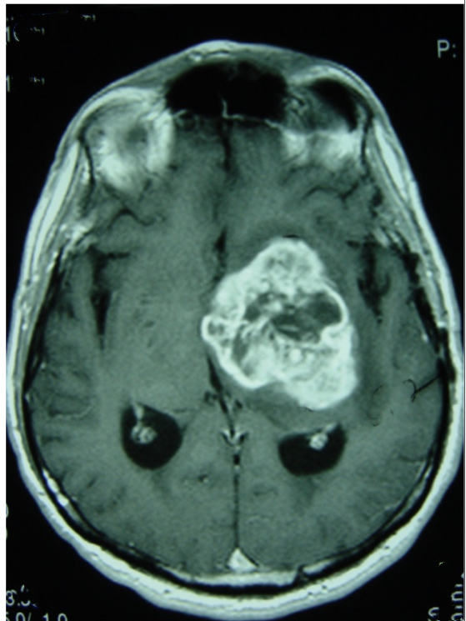
Background
Glioblastoma (GBM) is the most common and aggressive adult malignant brain tumor¹ and has substantial heterogeneity²
GBM has a 5-year survival rate of 5.1%³ and a median OS of 5-8 months following recurrence^{4,5}
No effective standard of care for recurrent GBM exists; treatment options include further surgery (if viable), clinical trials, or further chemotherapy⁶
Antitumor bioactivity of glioma-targeting CAR T cells was suggested in patients with malignant glioma (including GBM) in an ongoing clinical trial (NCT02208362); however, tumor heterogeneity possibly led to inadequate ORR and limited potency of adoptively transferred CAR T cells
A first-in-human phase 1 study is being conducted to investigate the safety of CLTX-CAR T cells, a novel immunotherapy developed by City of Hope (Duarte, CA), in patients with GBM
Thakkar JP, et al. Cancer Epidemiol Biomarkers Prev. 2014;23(10):1985-96.
Wang D, et al. Sci Transl Med. 2020;12(533):eaaw2672.
Ostrom QT, et al. Neuro Oncol. 2015;17(Suppl 4):iv1-iv62.
Gallego O. Curr Oncol. 2015;22(4):e273-81.
Weller M, et al. Neuro Oncol. 2013;15(1):4-27.
Central Nervous System Cancers. anaplastic gliomas/glioblastoma. NCCN guidelines version 4.2020.
CAR, chimeric antigen receptor; CLTX, chlorotoxin; CNS, central nervous system; GBM, glioblastoma; ORR, overall response rate; OS, overall survival.

Slide 3
Novel Features of CLTX-CAR T-Cell Therapy
CLTX-CAR T-cell therapy (CLTX(EQ)28ζ/CD19t+ T cells) uses CLTX as the tumor-recognition domain that identifies a multireceptor complex containing MMP2 for binding on GBM cells
Novel receptor-binding domain
Negligible killing of normal human cell lines, supporting safety
Tumor-targeting
CLTX peptide
E
Q
E
Q
Spacer/linker
IgG4-Fc(EQ)
Broad binding activity for GBM cells
No adverse effects with either systemic or regional administration in mice
Transmembrane
CD28
Costimulatory
CD28
Signaling
CD3ζ
CLTX-CAR
Greater binding activity for GBM cells compared with other immunotherapy targets
No off-target recognition of normal human/murine cells in preclinical models
Wang D, et al. Sci Transl Med. 2020;12(533):eaaw2672.
CAR, chimeric antigen receptor; CD, cluster of differentiation; CLTX, chlorotoxin; Fc, fragment crystallizable; GBM, glioblastoma; IgG, immunoglobulin G; MMP, matrix metalloproteinase.
3

Slide 4
CLTX-CAR T Cells Mediate Potent In Vivo Antitumor Activity
Tumor regression was observed in in vivo orthotopic GBM-xenograft mouse models after adoptive transfer of CLTX-CAR T cells via the ICT route
Quantification of ffLuc flux (photons/sec) for each mouse shows tumor regression upon ICT administration of CLTX-CAR T cells
Significantly improved survival following a single ICT administration of CLTX-CAR T cells (1×10⁶ CAR T cells) versus that of mock-transduced Tn/mem (no CAR) T cells
A.
B.
10⁹
Untreated
100
*
Mock
10⁸
CLTX-CAR
75
Untreated
10⁷
Mock
Tumor flux (photons/sec)
Survival (%)
CLTX-CAR
10⁶
50
10⁵
25
10⁴
0
0
20
40
60
80
100
120
0
25
50
75
100
125
150
175
Day
Day
*p=0.0004 using the log-rank (Mantel-Cox) test; p=0.008 for CLTX-CAR versus mock therapy.
Wang D, et al. Sci Transl Med. 2020;12(533):eaaw2672. CAR, chimeric antigen receptor; CLTX, chlorotoxin; ffLuc, firefly luciferase; GBM, glioblastoma; ICT, intracranial intratumoral.
4

Slide 5
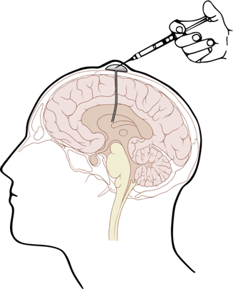
Phase 1 Study Design
Primary Endpoints: Toxicity, including DLTs, CRS, and all other toxicities; determine the MTD schedule and RP2D plan
Secondary Endpoints:
CAR T-cell and endogenous T-cell levels; phenotype; and cytokine levels in PB, TCF, and CSF
6-month PFS rate, 9-month OS rate, and median OS; CAR T-cell and CLTX antigen expression levels in tumor tissue
Biomathematical modeling of tumor growth
Patients ≥18 years old (KPS ≥60%, ECOG PS ≤2) with grade IV GBM with relapsed disease and ≥20% expression of CLTX-targeted antigen MMP2+ were included in the study.
Treatment consent
Catheter
placement
FDG-PET
MRI#
Screening
consent
FDG-PET
MRI
Leukapheresis
CLTX-28ζ-CAR T-cell infusion
Day*
–14
–7
0
7
14
21
28
LTFU
Screening and
leukapheresis
Cycle 1
Cycle 2
Cycle 3
Rest
Cycles 4+
CAR T-cell manufacturing
DLT evaluation period
*Days shown are approximate. #Imaging can occur any time between day 21 and day 35.
CAR, chimeric antigen receptor; CLTX, chlorotoxin; CRS, cytokine release syndrome; CSF, cerebrospinal fluid; DLT, dose-limiting toxicity; ECOG PS, Eastern Cooperative Oncology Group performance status; FDG-PET, fluorodeoxyglucose–positron emission tomography; GBM, glioblastoma; KPS, Karnofsky performance status; LTFU, long-term follow up; MMP, matrix metalloproteinase; MRI, magnetic resonance imaging; MTD, maximum tolerated dose; OS, overall survival; PB, peripheral blood; PFS, progression-free survival; RP2D, recommended phase 2 dose; TCF, tumor cyst fluid.
5

Slide 6
Phase 1 Treatment Schema
In a preliminary safety lead-in phase, patients are treated in Arm 1 and will receive a low dose of chlorotoxin-CAR T cells through the ICT catheter only
Patients will then be treated in Arm 2 in which CAR-T cells are administered both ICT and ICV via dual delivery; dose escalation would proceed as shown in the table
 | DS 1 de-escalation | DS 1 | DS 2 de-escalation | DS 2
Cycle 1 | A: 2×10⁶ | A: 4×10⁶ | C: 10×10⁶ | F: 20×10⁶
Cycle 2 | B: 10×10⁶ | C: 20×10⁶ | D: 50×10⁶ | H: 100×10⁶
Cycle 3 | B: 10×10⁶ | C: 20×10⁶ | D: 50×10⁶ | H: 100×10⁶
Total dose* | 25×10⁶ | 44×10⁶ | 110×10⁶ | 220×10⁶
Evaluation/restaging
Cycles 4+ | ≤10×10⁶ | ≤20×10⁶ | ≤25×10⁶ | ≤100×10⁶
Cycles unrestricted# | <10×10⁶ | <20×10⁶ | <25×10⁶ | <100×10⁶
*The dose listed for each cycle is the CAR T-cell dose intended for each delivery route. For dual delivery, 2 infusion doses will be prepared per infusion cycle, 1 each for the ICT and ICV delivery routes. To qualify for the dose-escalation portion of the study, the patient product must be able to deliver at least 80% of the total required cell dose for 3 cycles. #Unrestricted cycles are available after disease progression or if a patient has required a contraindicated drug.
CAR, chimeric antigen receptor; DS, dosing schedule; ICT, intracranial intratumoral; ICV, intracranial intraventricular.
6

Slide 7
Conclusions and Future Directions
CLTX-CAR T-cell therapy is a novel immunotherapy that has the potential to extend the range of solid tumors targetable by CAR T cells and has the scope to deliver a broad immuno-oncology platform
Results from our phase 1 study are expected to demonstrate the safety and feasibility of dual delivery of CLTX-CAR T cells in patients with recurrent GBM
In addition, this first-in-human phase 1 study will determine the MTD and RP2D plan
The study is actively enrolling, and 4 patients have been dosed as of mid-April 2021
CAR, chimeric antigen receptor; CLTX, chlorotoxin; GBM, glioblastoma; MTD, maximum tolerated dose; RP2D, recommended phase 2 dosing.
7

